Slide 1
ABC Call Volume Trend Analysis
VICTOR SHAH

Slide 2
Project description
As a data analyst my primary responsibility is to analyze customer feedback and data, derive insights from it, and share these insights with the rest of the organization. Furthermore, responsible for a wide range of tasks, including managing customer experience programs, handling internal communications, mapping customer journeys, and managing customer data, among others.
The data set provided spans 23 days and includes various details such as the agent’s name and ID, the queue time ( how long a customer had to wait before connecting with an agent), the time of the call, the duration of the call, and the call status (whether it was abandoned, answered, or transferred).

Slide 3
Approach
Downloading the dataset: The first step is downloading the excel file (.csv) into the local device. Make sure the downloaded file is having the extension (.xlsx).
Understanding the worksheet: The next step is to examine the structure of the table holding the data in the Excel Sheet.
(Call_Volume_Trend_Analysis_Project_9)
Identifying the key tables: Identification of the primary key from the dataset of excel files.
Data Cleaning: This is the preprocessing step that makes the data suitable for analysis. It include handling missing values, removing duplicates.
Data Visualization: To use EDA to understand how to derive insights and how to share insights with the rest of the organization.

Slide 4
Data analytics tasks

Slide 5
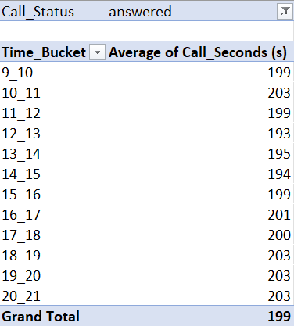
1. Average Call Duration: Determine the average duration of all incoming calls received by agents. This should be calculated for each time bucket.
For each time bucket the average duration is calculated. This is done by using the pivot tables in excel.
The time bucket having the highest average duration is 10_11, 18_19, 19_20, 20_21.
Another insight that can be gained is that the agents are much busier during the evening in comparison to the rest of the day.

Slide 6
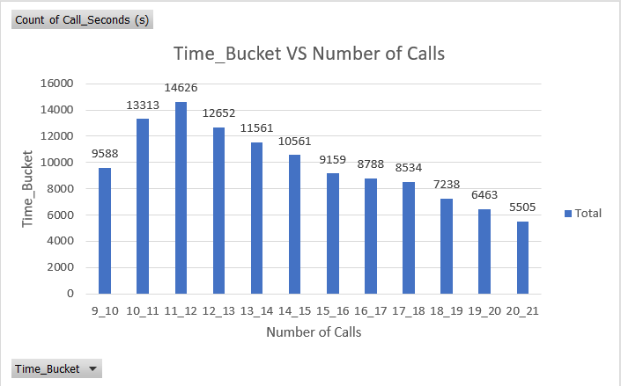
2. Call Volume Analysis: Visualize the total number of calls received. This should be represented as a graph or chart showing the number of calls against time. Time should be represented in buckets (e.g., 1-2, 2-3, etc.).
The time bucket having the highest number of calls is 11_12.
The time bucket having the lowest number of calls is 20_21.
This is a column chart used for visualization.

Slide 7
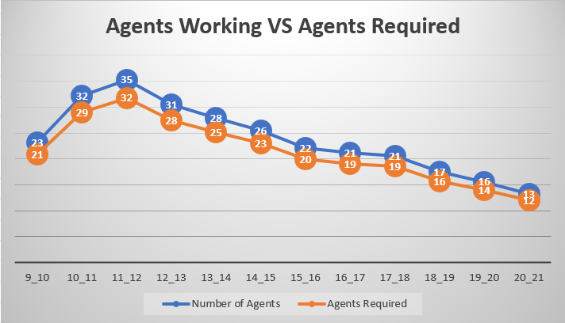
3. Manpower Planning: The current rate of abandoned calls is approximately 30%. Propose a plan for manpower allocation during each time bucket (from 9 am to 9 pm) to reduce the abandon rate to 10%. In other words, you need to calculate the minimum number of agents required in each time bucket to ensure that at least 90 out of 100 calls are answered.
For every time bucket we can see that we require a smaller number of agents from the existing staff so that the number of abandoned calls can be reduced from 30% to 10%.

Slide 8
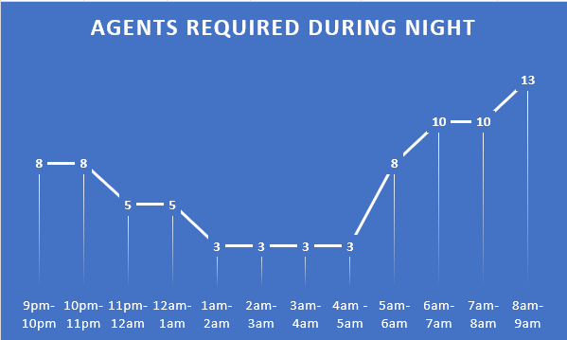
4. Night Shift Manpower Planning: Customers also call ABC Insurance Company at night but don't get an answer because there are no agents available. This creates a poor customer experience. Assume that for every 100 calls that customers make between 9 am and 9 pm, they also make 30 calls at night between 9 pm and 9 am.
For every time bucket we can see that we require a smaller number of agents from the existing staff so that the number of abandoned calls can be reduced from 30% to 10%.

Slide 9
Tech-stack used
Microsoft Excel: It is a spreadsheet program from Microsoft and a component of its Office product for business application. This enables users to format, calculate and organize data in a spreadsheet.
MS Excel Functions: They are predefined formulas that perform calculations by using specific values, called arguments, in a particular order or structure. Some of the functions are:
Text function: clean(), substitute(), replace(), concatenate(), trim(), etc.
Mathematical and Statistical functions: sum(), sumif(), count(), countif(), average(), averageif(), etc.
Data visualization in Excel: Bar, Line, scatter, stacked chart.

Slide 10
insights
To determine the average duration of all incoming calls received by agents. And this had to be calculated for each time bucket.
Visualizing the total number of calls received.
Propose a plan for manpower allocation during each time bucket (from 9 am to 9pm) to reduce the abandon rate to 10%. This means we had to calculate the minimum number of agents required in each time bucket to ensure atleast 90 out of 100 calls are answered.
Night Shift Manpower planning. We had to figure out the number of agents required at night. Because the customers do not get an answer as there are no agents available. This creates a poor customer experience.

Slide 11
Results
Remembering to adapt excel functions on specific dataset.
These learned insights helped me understand specific business questions which were addressed by MS Excel.
Learning about Excel Text and Statistical functions. The importance of average(), median(), mode(), text(), functions.
We were able to build different charts for visualization for answering the business questions. Some of the charts used were bar graph, stacked chart and heatmap.
Achieving the ability to learn and write MS Excel functions to execute different business questions.
Solving Company related problems using different visualization charts through the use of pivot tables.

Slide 12
THANK YOU

